Slide 1
mySetu: Safety Head
Issues

Slide 2
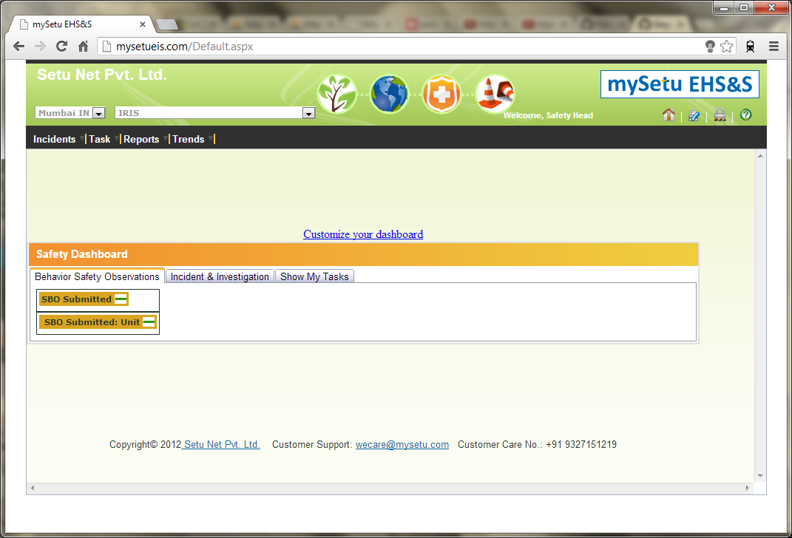
1. Home screen doesn’t suggest any reported incidents

Slide 3
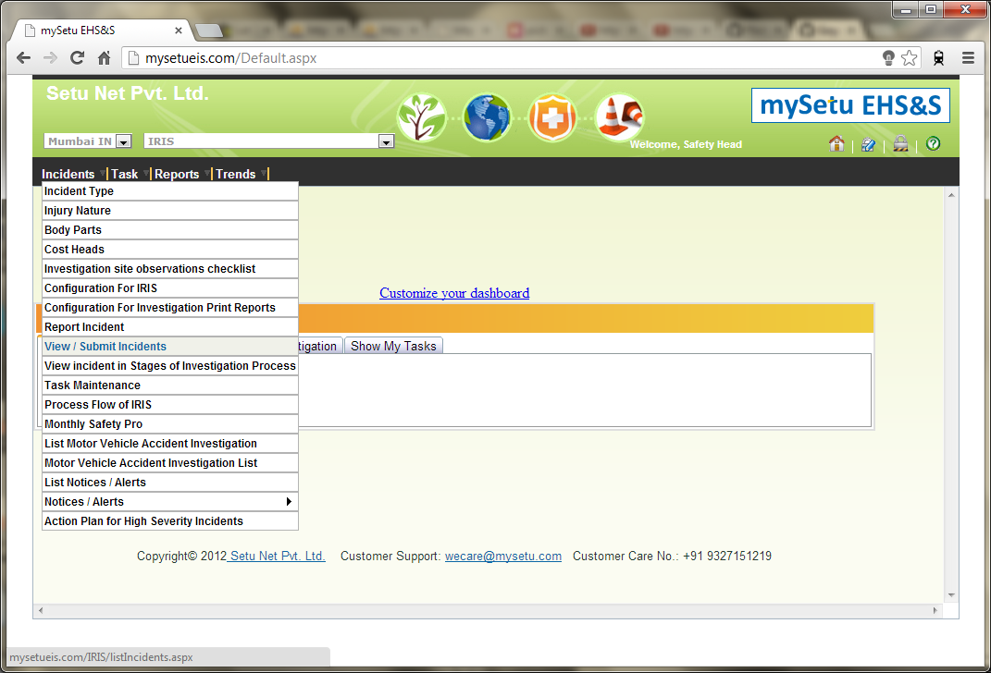
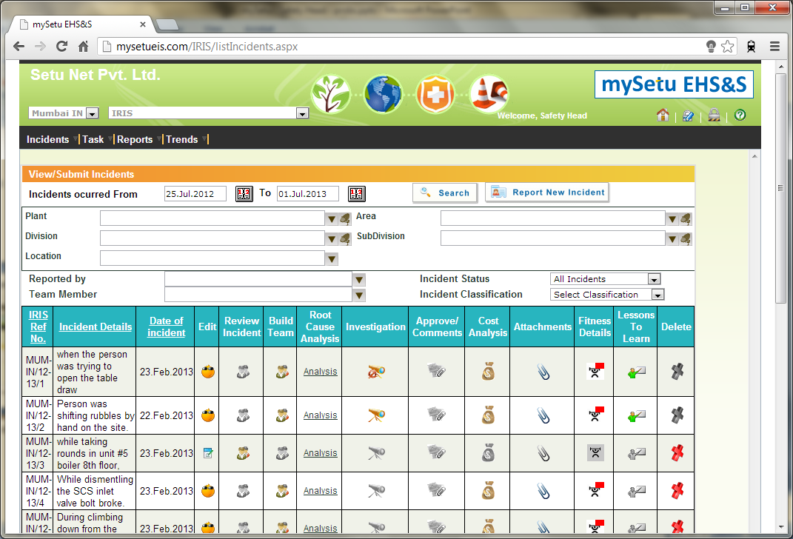
2. Too many steps required to find the reported problem
a. Search Incidents
b. Browse results

Slide 4
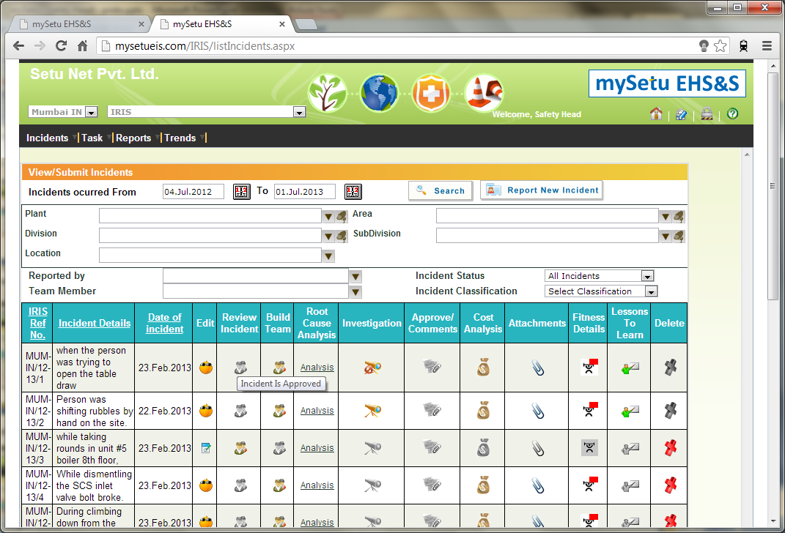
3. View/submit - Tooltips gives the status only

Slide 5
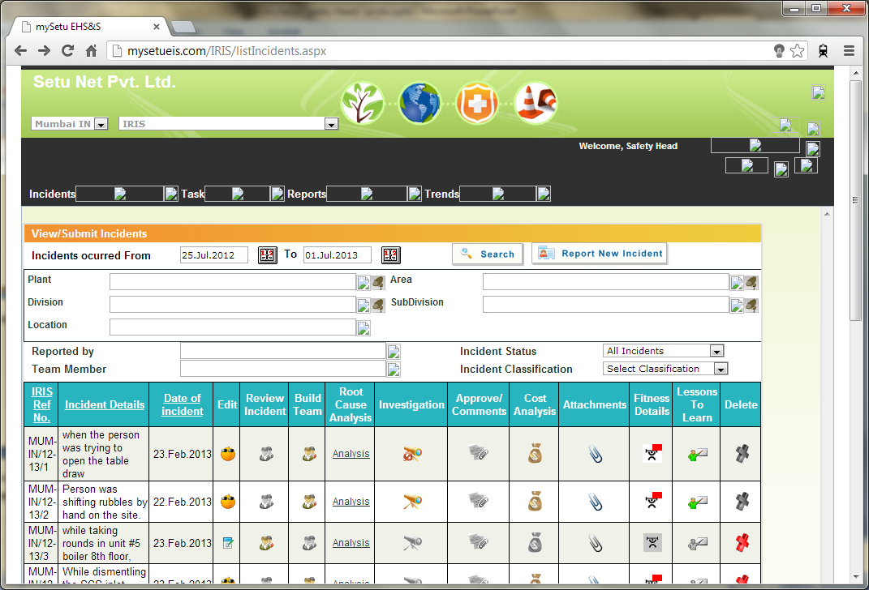
4. No way to sort the unapproved incidents

Slide 6
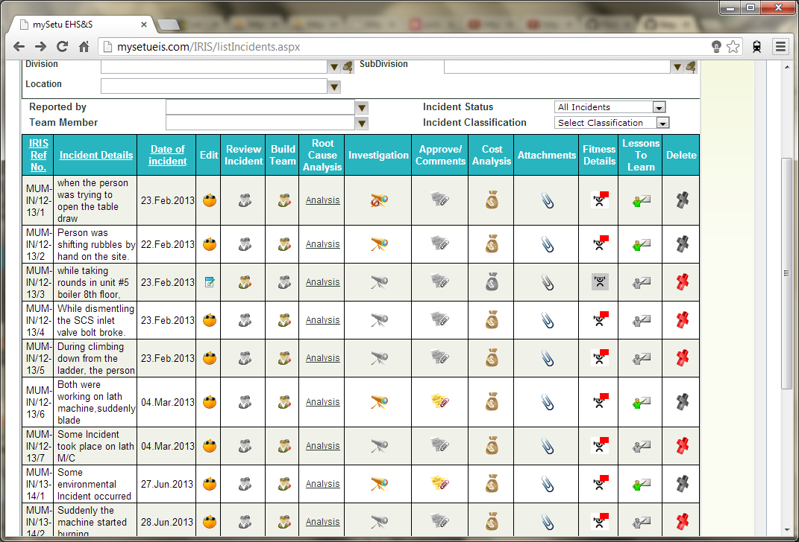
5. Different buttons for edit

Slide 7
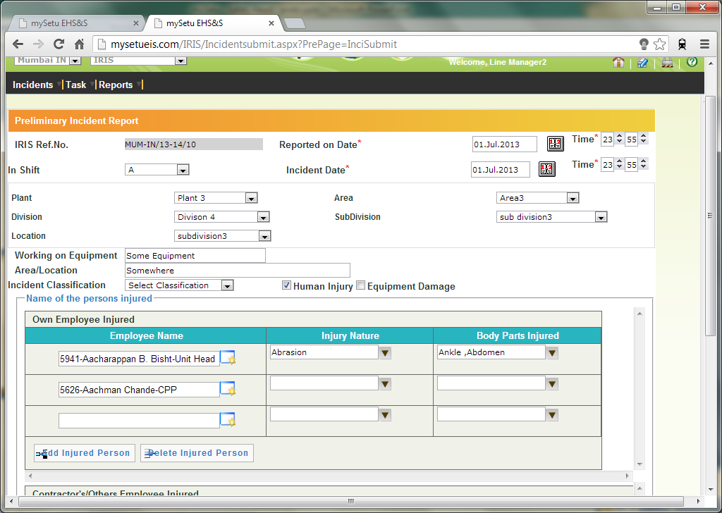
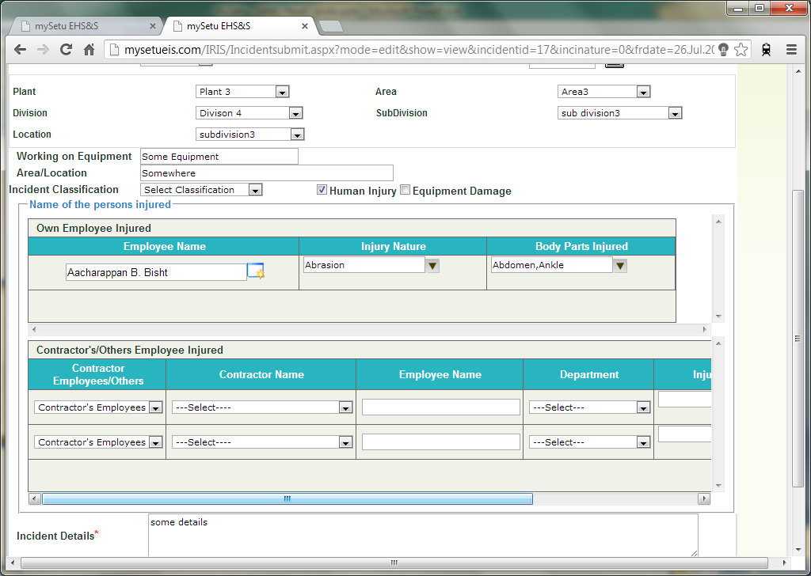
6. Employee name doesn't appear when incident is saved: error probably
a. Create Incident
b. View Incident

Slide 8
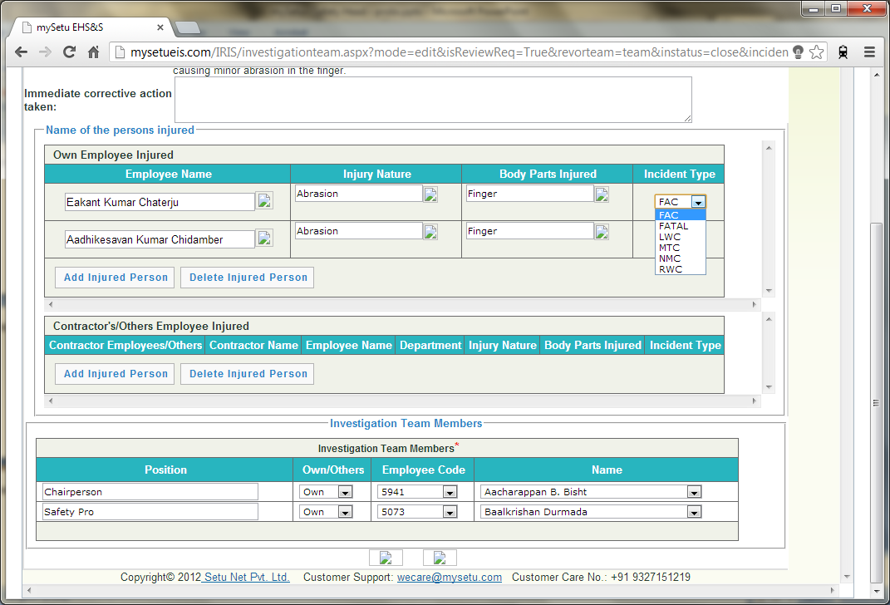
7. Incident type – definition required (LWC, FAC, etc.)

Slide 9
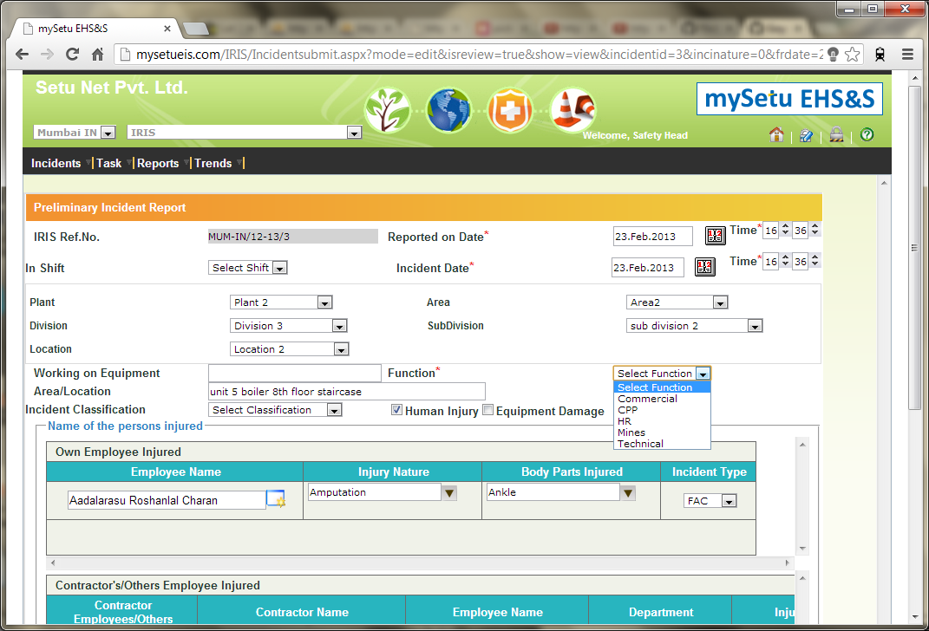
8. Function - definition missing (commercial, mines etc)

Slide 10
9. Function is the only required field

Slide 11
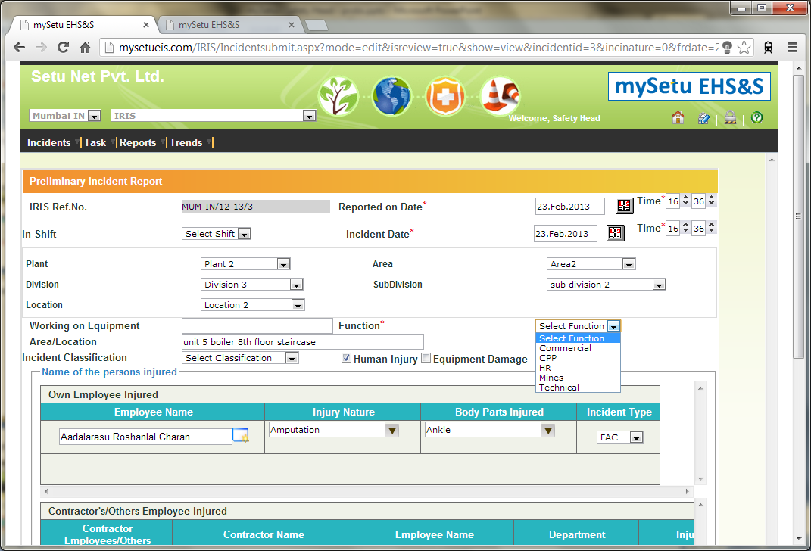
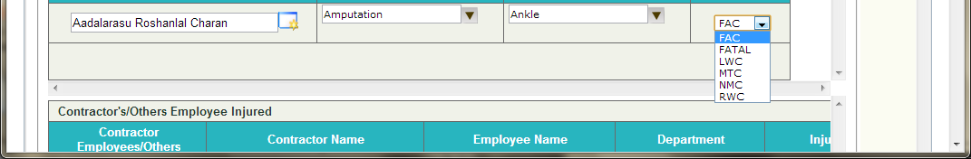
10. Incident type & function not defined as a proper task

Slide 12
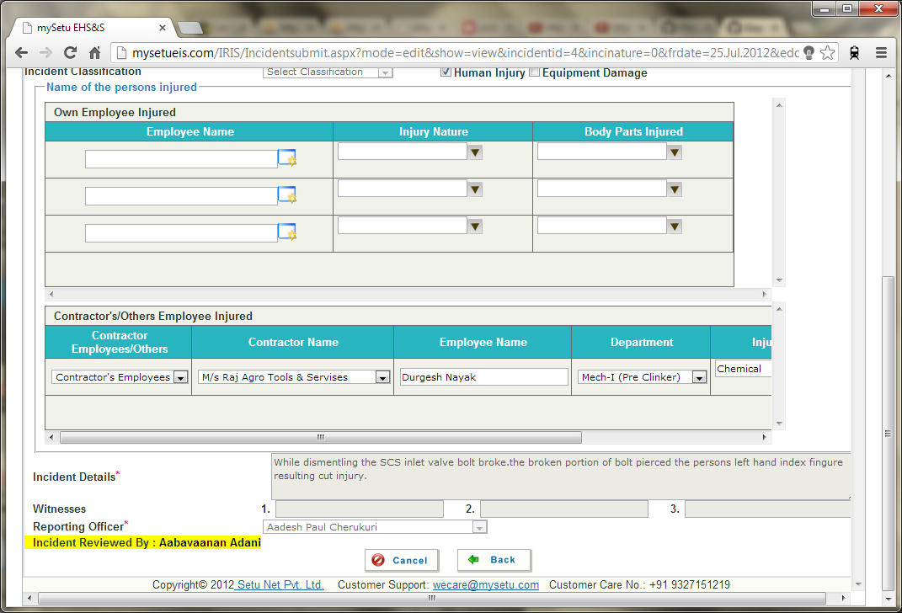
11. Incident ‘created by’ is missing

Slide 13
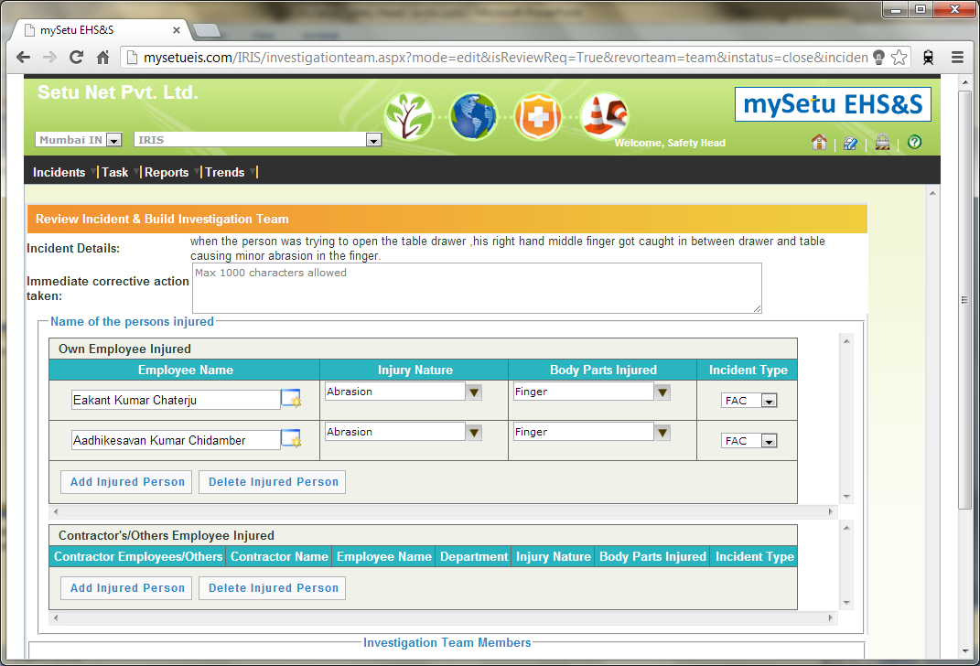
12. Build Team: Immediate corrective action taken - is it required?

Slide 14
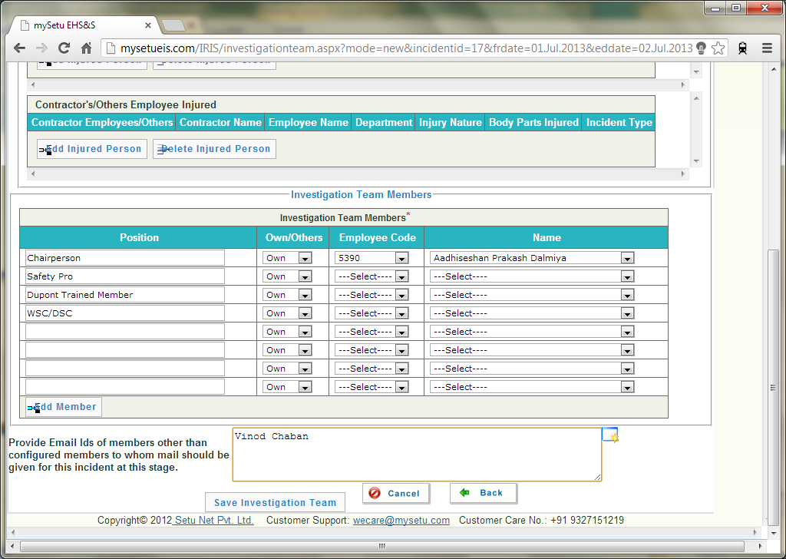
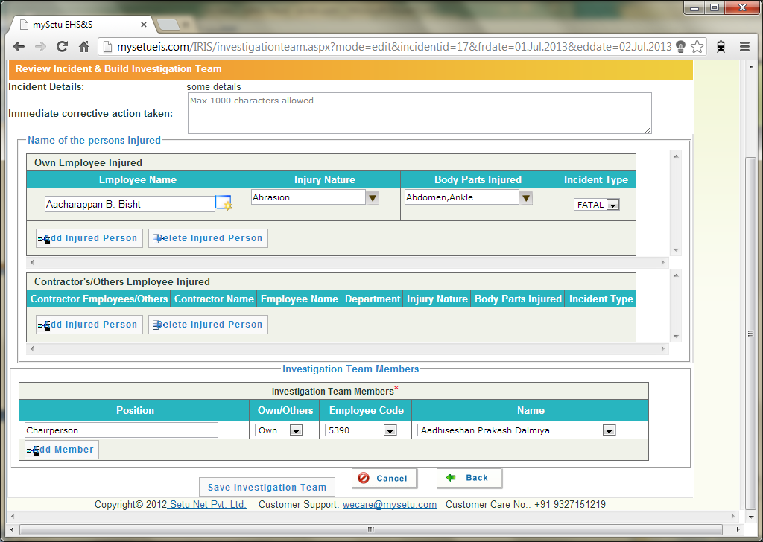
13. Build Team - additional members email id lost once submitted
a. Before saving
b. After saving
Missing email ids

Slide 15
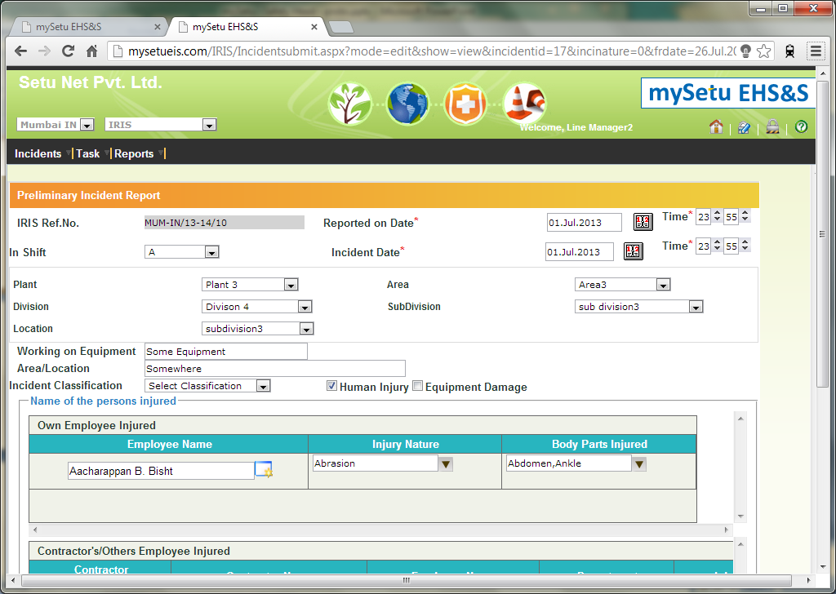
14a. Create/Edit/Approve/Create team - multiple page
Create
Edit

Slide 16
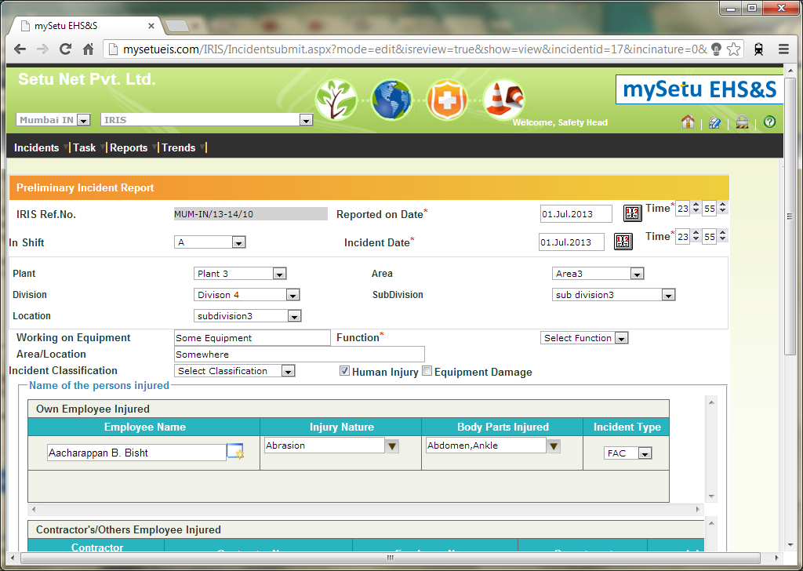
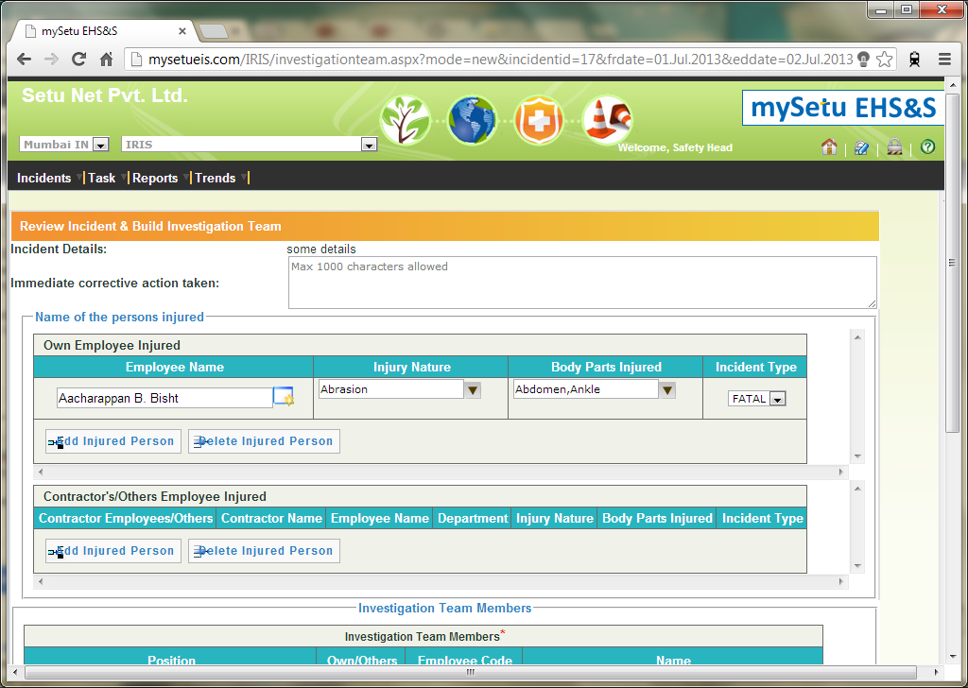
14b. Create/Edit/Approve/Create team - multiple page
Review Incident
Build Team
Immediate corrective action taken
Function
Incident Type
Investigation Team Members

Slide 17
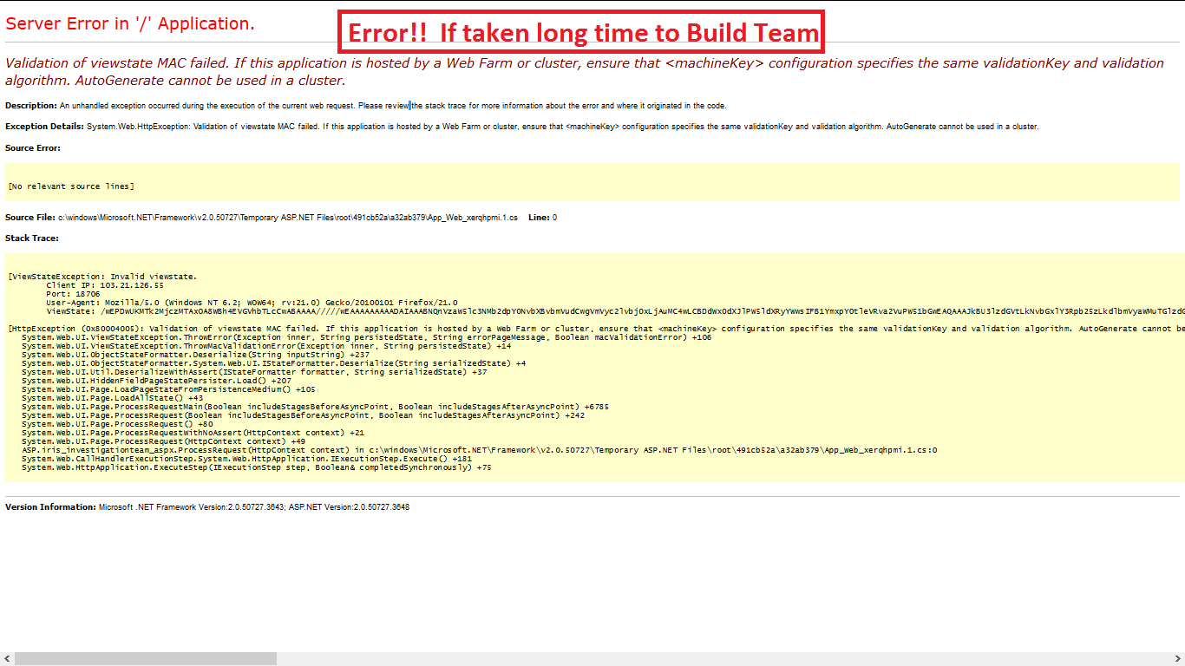
15. Form data lost: when session has expired

Slide 18
Summary
TODOs left - Notifications required on home screen
how many steps required to find the reported problem
view/submit - Tooltips gives the status
sort on the unapproved problem
Employee name doesn't appear
FAC definition required
Function - definition (mines etc)
Function is required field
incident type & function not defined as a task
Edit different buttons
Differentiate Reported by and created by
Create/Edit/Approve/Create team - one page
Immediate corrective action taken - is it required?
Investigation team members - Position and Name are not related
Login popup - when session has expired
Name of extra email names

Slide 19
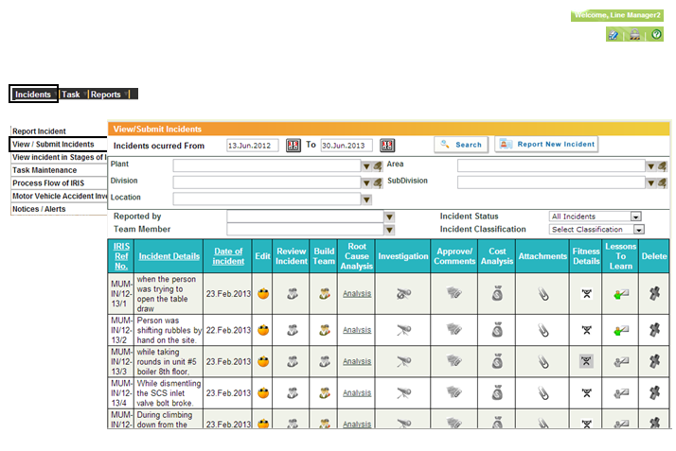
Left-Navigation

Slide 20
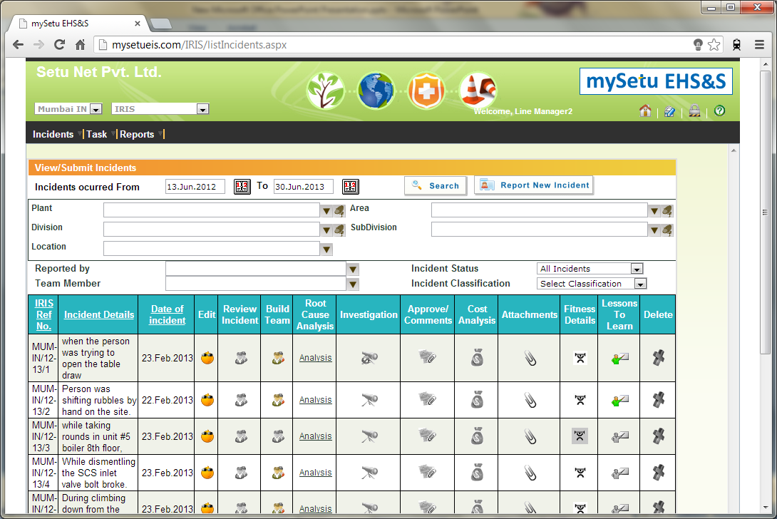
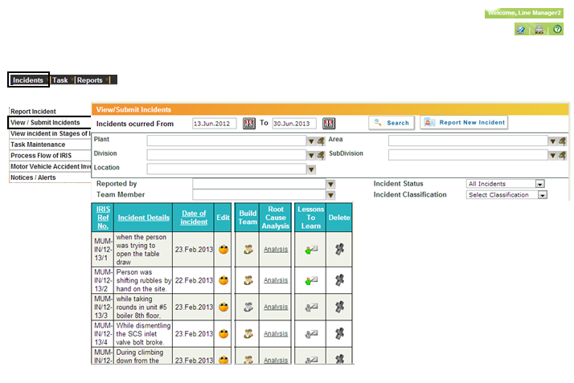
Comparison

